Slide 1


What are other universities doing to support RDM?
Sarah Jones
Digital Curation Centre
sarah.jones@glasgow.ac.uk
Twitter: @sjDCC
RDM steering group meeting, 19th November 2014, Cardiff Metropolitan University

Slide 2
Outline
Drivers for Research Data Management
Overview of roles and services
Specific examples of work in other unis

Slide 3

Expectations of public access
“Publicly funded research data are a public good, produced in the public interest, which should be made openly available with as few restrictions as possible in a timely and responsible manner that does not harm intellectual property.”
RCUK Common Principles on Data Policy
www.rcuk.ac.uk/research/Pages/DataPolicy.aspx

Slide 4
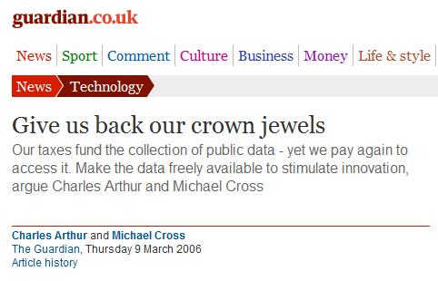
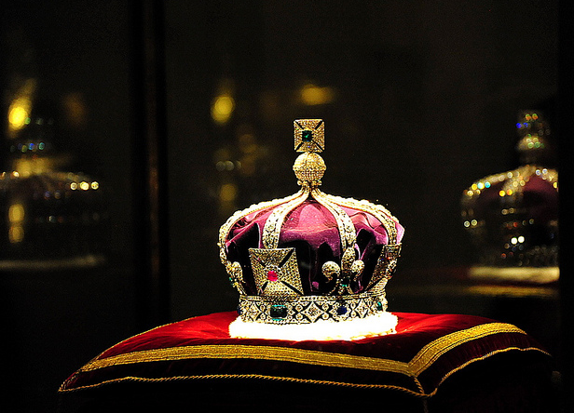
Research data: institutional crown jewels?
http://www.flickr.com/photos/lifes__too_short__to__drink__cheap__wine/4754234186/

Slide 5

Returns for institutions
“If an institution spent A$10 million on data, what would be the return? The answer is: more publications; an increased citation count; more grants; greater profile; and more collaboration.”
Dr Ross Wilkinson, ANDS
www.ariadne.ac.uk/issue72/oar-2013-rpt
Notes:
He was making a comparison with the Hubble telescope, which A$1.5 billion is spent on each year. The cost of the Hubble archive (A$1 million per annum) is just a fraction of this, but given the OA mandate, they’ve see the research publications produced by Hubble discoveries double.

Slide 6

Jisc MRD programmes
Managing Research Data programmes funded by the Jisc:
MRD 01: October 2009 – July 2011
  £4.3 million investment
  www.jisc.ac.uk/whatwedo/programmes/mrd.aspx
MRD 02 – October 2011 – July 2013
  £4.6 million investment
  www.jisc.ac.uk/whatwedo/programmes/di_researchmanagement/managingresearchdata.aspx
Programme Manager: Simon Hodson s.hodson@jisc.ac.uk
Twitter: #jiscmrd

Slide 7
DCC Institutional Engagements
With funding from HEFCE we:
Worked intensively with 21 HEIs to increase RDM capability
  Up to 60 days of effort per HEI drawn from a mix of DCC staff
  Deploy DCC & external tools, new approaches & best practice
Support varied based on what each institution wants/needs
Lessons & examples shared with the community
www.dcc.ac.uk/community/institutional-engagements

Slide 8
Who should be involved?
Funders
Advisory bodies
Data centres
Research Organisations
Support services
Publishers
Researchers
IT
Library
Ethics
Research office
...

Slide 9
Common RDM activities
Establishing steering groups
Making the case for RDM
Assessing needs
Developing policy and strategy
Piloting tools
Allocating higher quantities of research data storage
Data repositories
Catalogues / registers of data holdings
Delivering training & setting up guidance websites
...

Slide 10
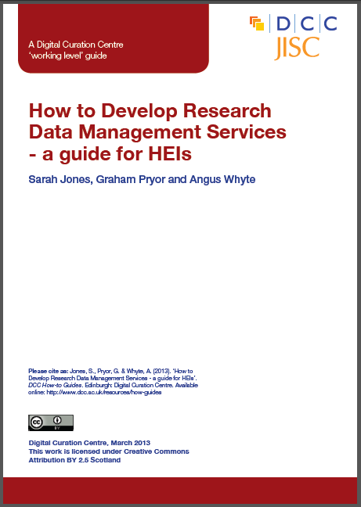
How to develop RDM services
And case studies:
Training for librarians
Repositories for data
Implementing strategy
Developing RDM services at Monash Uni
...
www.dcc.ac.uk/resources/
developing-rdm-services

Slide 11
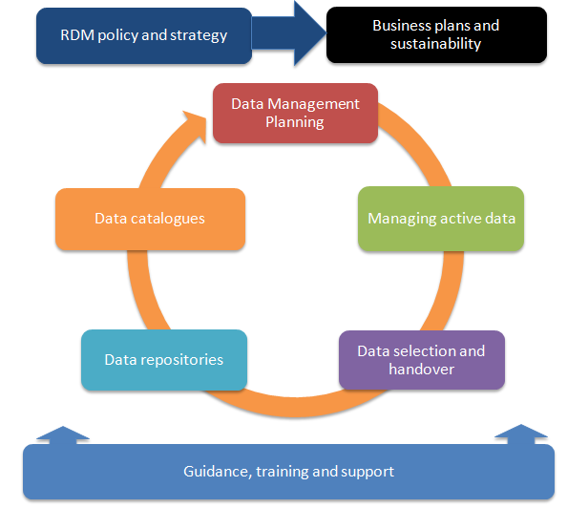
Components of RDM services

Slide 12
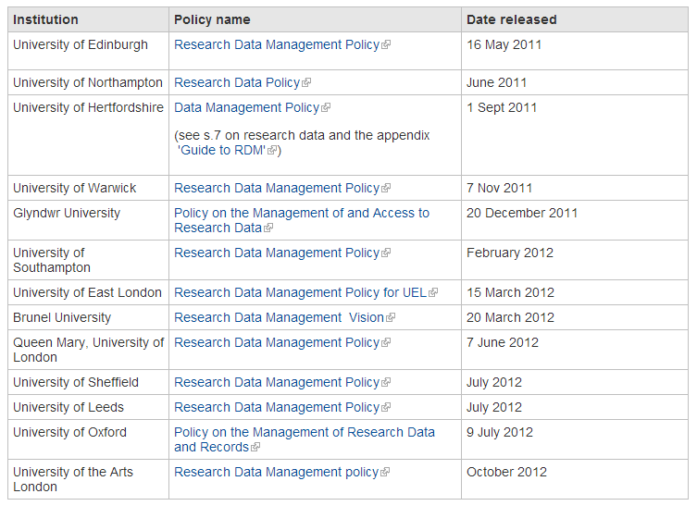
Institutional RDM policies
www.dcc.ac.uk/resources/policy-and-legal/institutional-data-policies

Slide 13




Early research data policies
Baseline of RCUK Code
+ procedures & support
legal tone / language
a section in uni DM policy
useful guide as appendix
Adopts the RCUK Common Principles and outlines what support will be provided
Based on Uni of Edinburgh’s ‘10 commandments’ with a few tweaks & additions

Slide 14
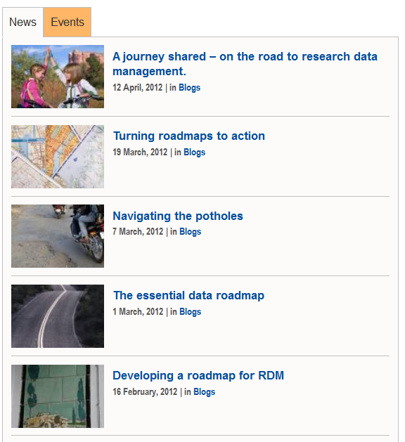
RDM strategies and roadmaps
A series of blog posts
www.dcc.ac.uk/blog
Links to example roadmaps
www.dcc.ac.uk/resources/
policy-and-legal/
epsrc-institutional-roadmaps

Slide 15
Oxford Brookes roadmap
Based on their own policy
Defines data as including art work, recordings, video etc
11 principles that apply to staff and research students
For each principle: what we do & what we want to do
Plans work on CRIS, DMPonline, training courses, use of RADAR repository, assigning DOIs etc
www.brookes.ac.uk/Documents/Research/Policies-and-codes-of-practice/ Research-data-management-policy

Slide 16
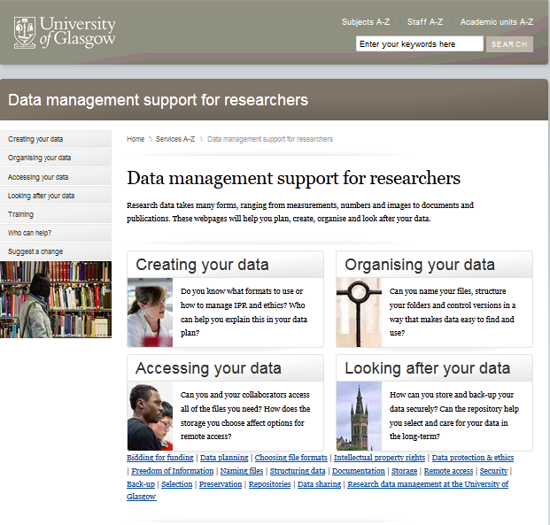
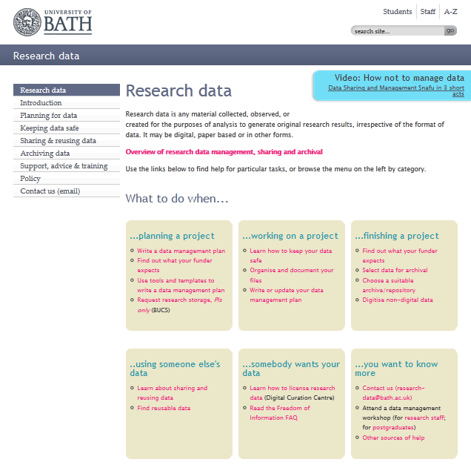
Guidance webpages
www.gla.ac.uk/datamanagement
www.bath.ac.uk/research/data

Slide 17
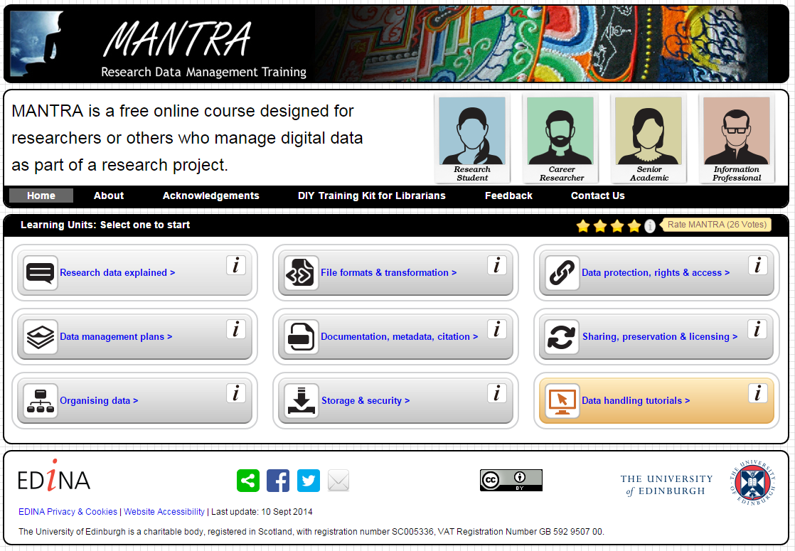
Online training in RDM
http://datalib.edina.ac.uk/mantra

Slide 18
Training for support staff
SupportDM course developed by University of East London
About Research Data Management
Guidance and support for researchers
Data management planning
What data to keep and why
Cataloguing data
Sharing data
Online modules, presentations and ‘homework’ exercises
www.uel.ac.uk/trad/outputs/resources

Slide 19
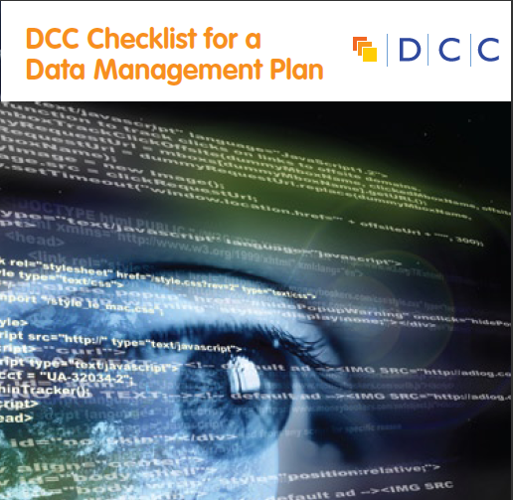
Data Management Planning support
Guidelines / templates on what to include in plans
Example answers, guidance and links to local support
A library of successful DMPs to reuse
Tailored consultancy services
Links / flags embedded in grant systems
Online tools
...

Slide 20
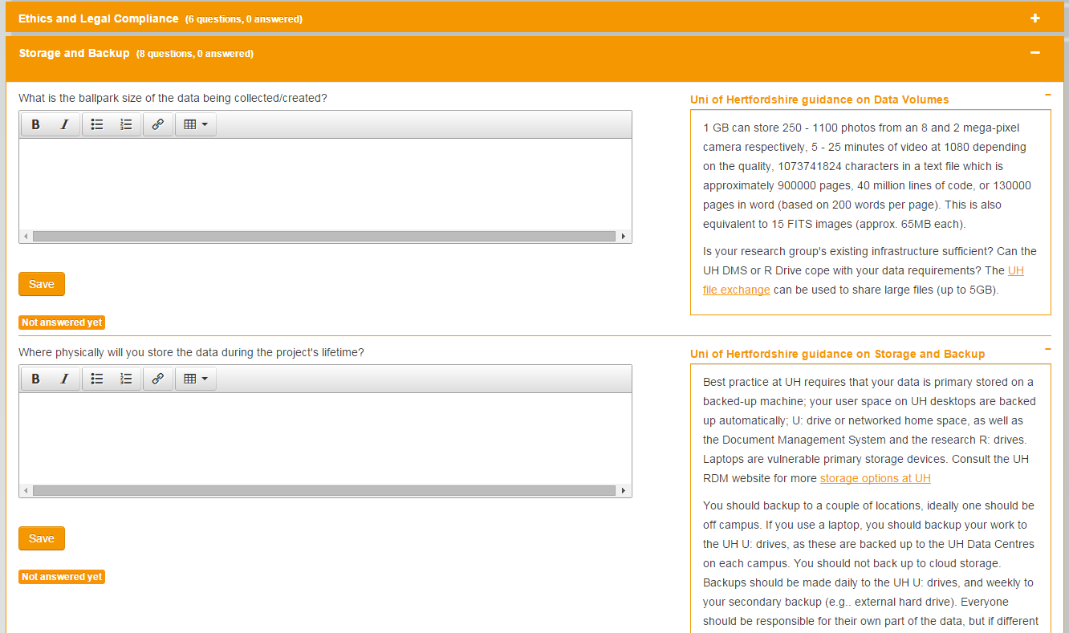
Hertfordshire DMP template

Slide 21

Tools – an ‘academic dropbox’
Piloting of OwnCloud at the University of Lincoln
An open source tool that provides similar features to Dropbox
  Web interface for uploads
  File and folder sharing with individuals and groups
  File versioning
  …
Integrated with ‘workspace’ developed by Orbital project for Engineering
Found it wasn’t ready ‘out of the box’ for institution-wide adoption, but still very positive about potential
  http://tiny.cc/owncloud-pilot
Since then it’s been adopted at the University of Edinburgh and Jisc have been discussing with Box.com about services via the Janet brokerage

Slide 22
Research data storage at Herts
Details from Bill Worthington’s post to research-dataman:
Acquired 100TB of tier 2 storage which will be backed up to tape for device level recovery
Default offer will be 50GB but established an RDM triage system and will accommodate < 5TB on the basis of need
10TB of Arkivum A-stor for 10 years for archival storage bolted onto Dspace institutional repository in order to support long term preservation of datasets
http://www.herts.ac.uk/rdm

Slide 23
Data repository examples
Data.uel
ePrints based data repository
Can deposit data and link it to publications in ROAR
Provides DOIs and Altmetrics
Supported by ULCC
http://data.uel.ac.uk
RADAR at Oxford Brookes
Collaborating with Sonic Arts Research Unit
Using IR as ‘back-end’ for audio and other data visible via project websites & blogs
RADAR based on Equella
www.dcc.ac.uk/resources/ developing-rdm-services/repository-radar

Slide 24
Data catalogues
Several unis have been using CKAN for RDM
  An open source data store, catalogue and publishing platform
  Used for open government data
  http://orbital.blogs.lincoln.ac.uk/2013/02/27/ckan-for-rdm-workshop
Other options include using institutional repository or CRIS system to create a log of data holdings
Also a Jisc / DCC project to create a national register like that harvests from institutional catalogues
  http://www.dcc.ac.uk/projects/research-data-registry-pilot

Slide 25
Outsourcing: Loughborough
Loughborough University has announced a venture to deliver an ‘integrated solution for its research data management’ by commissioning:
FigShare: active data storage
Arkivum: long-term digital archiving
Symplectic: research information systems
www.researchinformation.info/news/news_story.php?news_id=1758

Slide 26
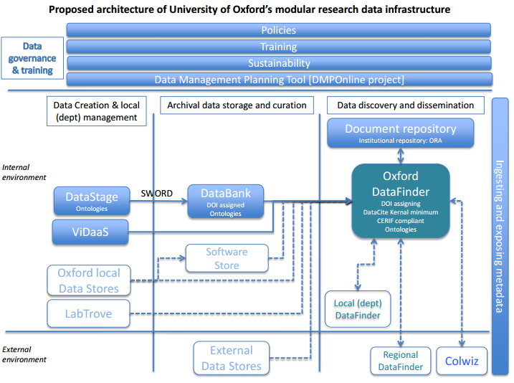
Bringing it all together into a service
Diagram courtesy of Sally Rumsey, University of Oxford

Slide 27

Thanks – any questions?
DCC guidance, tools and case studies:
www.dcc.ac.uk/resources
Follow us on twitter:
@digitalcuration and #ukdcc

