Slide 1



RDM From Strategy to Action?
Results from Digital Curation Centre’s 2014 Survey of UK Higher Education Institutions
Angus Whyte

Slide 2
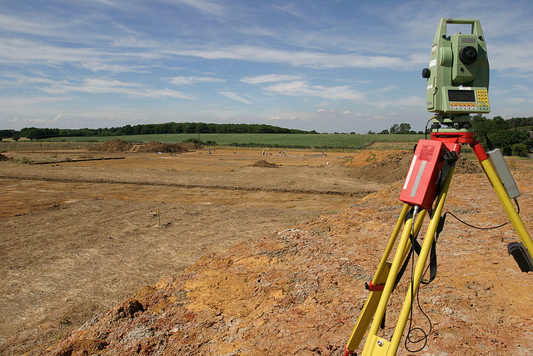
What, Why & How
National picture of institutional progress
Understand barriers, gaps in support needs
20 questions – online survey link emailed *
To Pro-VC’s for Research & Service Heads
Library, IT, Research Support & Commercialisation
Institutions at least 10% income from research
* Thank you to ARMA, UCISA, SCONUL!

Slide 3
Who took part?

Slide 4
Who took part

Slide 5

Institutional drivers

Slide 6
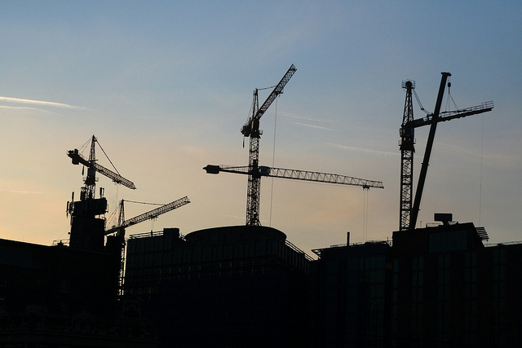
Where is there most progress?

Slide 7
Getting there?

Slide 8
Where is there least progress?

Slide 9
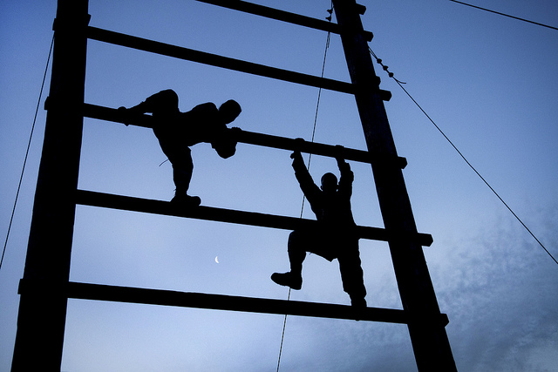
Obstacles

Slide 10
External Support?

Slide 11
Expected timeline for enabling long-term access to research data

Slide 12
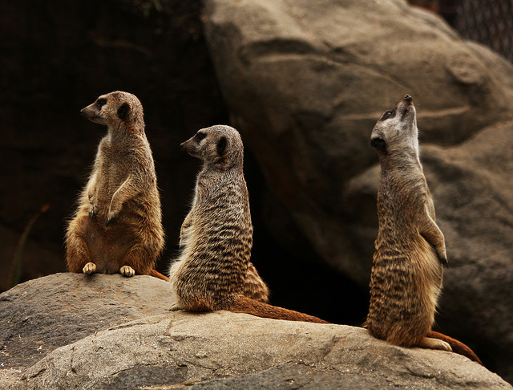
‘Progress has little to do with speed, but much to do with direction’ (anon.)
What is your bottom line?
70% want to collaborate or already are
Where can funders & DCC help more?

Slide 13
Questions?
Photo credits
Muffinn. 2010. Lanzarote staircase https://flic.kr/p/8WQVRb CC-BY
Nightingale, J. 2006. Push for Help https://flic.kr/p/98gN7 CC-BY-SA
Pei, B.2010 Work in progress https://flic.kr/p/8XTp8v CC-BY-NC-SA
Rocha, H. 2002. Inside Zollverein https://flic.kr/p/gmH3L CC-BY-SA
US Army. 2012. Overcoming Obstacles https://flic.kr/p/bExfoR CC-BY
See, J.2009. Works in Progress https://flic.kr/p/6BjnWy CC-BY
Stowe, R. 2009. Photograph of a Meerkat Family https://flic.kr/p/6S7fwu CC-BY
Taylor, T. 2005. Sunset Ripple https://flic.kr/p/2igqj CC-BY
Wessex Archeaology. 2005. Survey Equipment https://flic.kr/p/7xzxG5 CC-BY-NC-SA

